Slide 1

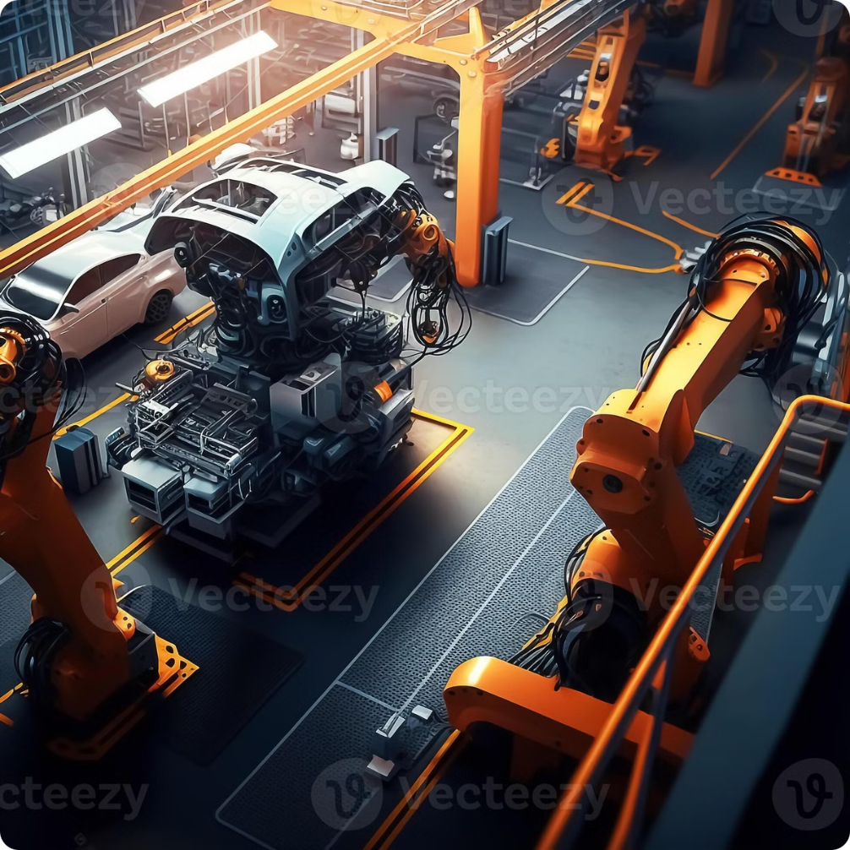

IIoT-Powered Smart Car Manufacturing and Digital Twin Integration for Cars
This presentation explores the exciting potential of IIoT and digital twins to revolutionize car manufacturing. Integrating these technologies enables enhanced production efficiency, real-time performance monitoring, and data-driven decision making. By leveraging connected devices and virtual representations of physical assets, we can optimize processes, improve quality, and drive innovation in the automotive industry.
by V D Panduranga Sai Guptha

Slide 2
Agenda
1
Drawbacks
2
Limitations
Examining existing challenges in the manufacturing sector, including common issues with current systems.
Addressing constraints in data, model accuracy, and integration challenges affecting initial development.
3
Idea Introduction
4
System Architecture
Introducing the core concept of the project, outlining its purpose, goals, and expected impact.
Exploring the overall structure and key components of the proposed system architecture.
5
Future Advancements
6
Protocol Selections
Envisioning potential upgrades and advancements for the system to meet future industry demands.
Discussing the protocols chosen for this system, such as MQTT and OPC UA, and their compatibility.
7
Introduction to Middleware for Legacy Systems
8
Outputs of Development
Overview of the middleware that bridges MQTT and OPC UA, enabling integration with legacy systems.
Showcasing the outcomes and functionalities achieved through the development process.

Slide 3

Drawbacks
Data Scarcity
Complexity of System Integration
Limited data availability can hinder model accuracy and reliability.
Connecting diverse systems and devices is challenging and may lead to compatibility issues.
Dependency on Stable Connectivity
High Implementation Costs
The system's performance relies heavily on consistent, high-quality network connections. Wired or wireless
Integrating IoT and digital twin technology requires significant investment in infrastructure.

Slide 4
Limitations
Lack of Real-Time Data
Dependency on Legacy Systems
Limited access to live data makes it difficult to train and validate models effectively.
Integrating new technologies with outdated systems can be challenging and may limit functionality.
Initial Model Accuracy
Limited Testing Environment
Without extensive data, initial models may lack precision and require further refinement.
Simulations might not capture all real-world conditions, impacting model robustness.
Hardware Constraints
High Implementation Cost
Dependence on compatible sensors and devices limits flexibility and scalability.
The initial cost of integrating IIoT and digital twin technology can be substantial, especially for smaller manufacturers.
Data Processing Power
Data Security Concerns
Handling and analyzing large datasets requires significant computational resources.
Handling sensitive manufacturing data requires robust security measures, which may add complexity to the system.

Slide 5
Idea Introduction
Develop an IIoT system using an OPC server and MQTT protocol for efficient data exchange and remote monitoring.
System architecture involves:
Sensors: Collect data, converted through an analog-to-digital circuit.
OPC Server: Acts as the central hub for data management.
Key client integrations include:
SCADA Tools: For graphical data visualization and monitoring.
Digital Twin Platform: Mirrors real-time conditions, supports feature extraction, predictive modeling, and condition analysis.
MQTT Publisher: Enables data broadcasting for cloud integration and storage.
Provides user access to:
Digital Twin Portal: To monitor parameters, train predictive models, and perform condition-based monitoring.
Allows for real-time data access through MQTT subscribers and a mobile client for remote control, optimizing industrial process efficiency and reliability.

Slide 6
System Architecture for IIoT-Powered Smart Car Manufacturing
Sensors
1
Sensors on the shop floor collect real-time data on production processes, machine performance, and environmental conditions.
2
Data Acquisition
Data from sensors is collected and transmitted to the OPC server, acting as a central data hub.
OPC Server
3
The OPC server publishes and manages data from various sources, providing a standardized interface for communication.
4
Cloud Integration
Data is transferred to the cloud platform for storage, processing, and analysis, allowing for real-time monitoring and insights.
Decision Making
5
Analytical tools and AI algorithms process data, providing valuable insights for optimizing production and identifying potential issues.
6
Actuator Control
Based on analyzed data and user input, commands are sent back to the shop floor to control actuators and adjust production processes.
SCADA Tool
7
SCADA is a control system used for monitoring and managing industrial processes in real-time, enabling centralized data collection, visualization, and automation.

Slide 7
System Architecture for Digital Twin Integration for Cars
Sensor Installation
1
Sensors are installed in the vehicle to monitor various parameters such as engine performance, tire health, and environmental conditions. These sensors provide real-time data crucial for the digital twin model.
2
Data Collection
The sensors continuously collect data, ensuring comprehensive coverage of the vehicle's operational state. This real-time data forms the foundation for analysis and modeling in the digital twin..
OPC Server Configuration
3
An OPC (Open Platform Communications) server is set up to standardize communication between different sensor data sources. This server manages and publishes the collected data efficiently..
4
Data Transmission to Cloud
The collected data is transmitted to a cloud platform for secure storage and advanced processing. This enables powerful analytics and real-time insights into the vehicle’s performance.
Digital Twin Model Development
5
A digital twin of the car is created using the real-time sensor data, accurately reflecting its physical state. This model allows for simulation and analysis of the vehicle's behavior under various conditions.
6
User Interface Development
A user-friendly interface is developed for visualizing the digital twin and accessing insights. This interface enables users to monitor vehicle performance and receive alerts regarding potential issues.
Continuous Monitoring and Feedback
7
Continuous monitoring ensures the digital twin is updated with real-time data from the vehicle. A feedback loop allows adjustments based on insights derived from the digital twin, enhancing vehicle performance and maintenance.

Slide 8
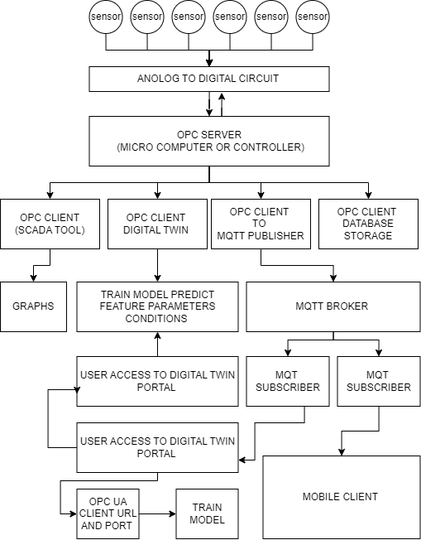
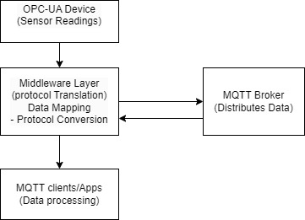
System Architecture for Digital Twin Integration for Cars
Middleware Layer Legacy Systems

Slide 9
Protocol Selections
OPC-UA (Open Platform Communications - Unified Architecture):
Used as the primary protocol between the OPC Server (microcontroller or microcomputer) and various OPC Clients (such as SCADA tools, digital twin platforms, MQTT publisher, and database storage).
MQTT (Message Queuing Telemetry Transport):
Used to facilitate communication between the OPC Client acting as an MQTT publisher and the MQTT Broker.
Enables low-bandwidth, real-time messaging to MQTT Subscribers and Mobile Clients, which is efficient for IIoT environments.
HTTP/REST:
Used to enable User Access to the Digital Twin Portal, allowing clients to interact with the system over the web.
Future Advancements
Integration of AI and ML for Advanced Predictive Analytics
Enhanced Real-Time Data Processing
Scalability for Larger Sensor Networks
Improved User Interface and Mobile Compatibility
Advanced Security Measures
Support for Additional Communication Protocols

Slide 10
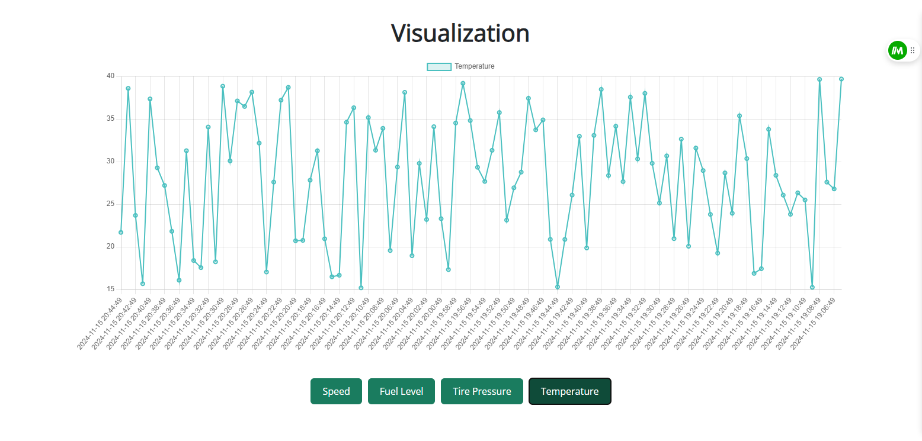
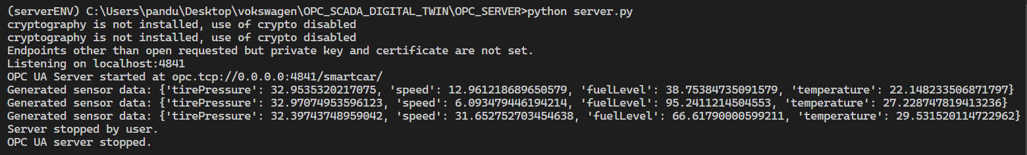
Outputs of Development

Slide 11
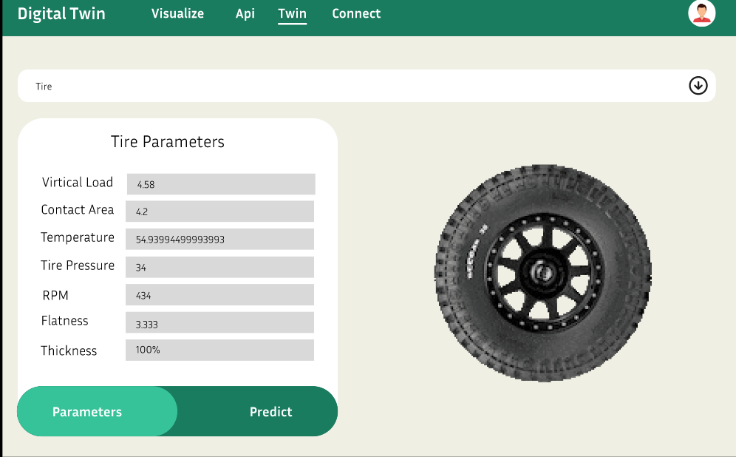
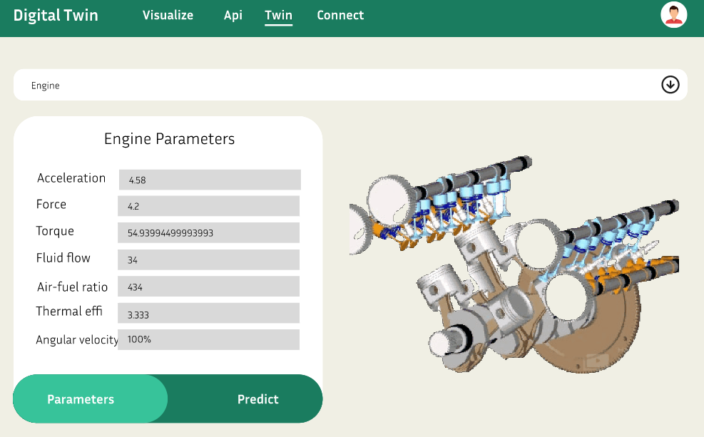
Outputs of Development

